Slide 1
BDPNN
Final Deliverable
Notes:
Manan

Slide 2
1.
Project Goals
Notes:
Riya

Slide 3
Project Goals
Using BDPNN’s member lists and disaster zoning datasets, develop recommendations for:
Increase Member Engagement
Identify Community Outreach Locations
1
2
Improve emergency Preparedness
Perform Risk
Analysis
3
4
Notes:
Riya

Slide 4
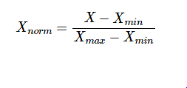
Methodology
03
Data Collection
BDPNN provided demographic and membership data.
California natural disaster data was sourced from various online resources.
Data Cleaning & Processing
The data was loaded into shared notebooks to fix or remove incorrect, corrupted, improperly formatted, duplicate, or incomplete data within the dataset.
01
04
02
Heuristic Building
Here we chose 5 features as the input of our formula, and each of them have been normalized using the below formula.
Exploratory Data Analysis
Data visualizations were made in DeepNote notebooks using Python libraries and Tableau to identify patterns/ abnormalities.
03
03
Notes:
Manan
Data Collection:
BDPNN provided demographic and mentorship data. Since BDPNN’s founding in 2009, the organization has developed and maintained a database of information containing:
- A list of member contact information
- Berkeley neighborhood block groups
- I/O mailing lists
- Record of workshops held
California natural disaster data was sourced from various online resources.
- Flooding/Wildfire datasets were sourced from Kaggle.
- Earthquake datasets were sourced from the US Geological Survey
Exploratory Data Analysis:
Data visualizations were made in DeepNote notebooks using Python libraries and Tableau to identify patterns/abnormalities. Tools Used: DeepNote, Python, Pandas, Numpy, Matplotlib, Seaborn, Geopy, Geopandas, Folium, Tensorflow, Tableau
Data Cleaning & Processing:
The data was loaded into shared notebooks to fix or remove incorrect, corrupted, improperly formatted, duplicate, or incomplete data within the dataset.
Tools Used: DeepNote, Python, Pandas
Heuristic Building:
Here we chose 5 features as the input of our formula, and each of them have been normalized using below formula.

Slide 5
2.
Member & Demographic Analysis
Notes:
Victor

Slide 6
Data Sources
1) Member Database Files
BPDNN IO Group: approx 325 contacts, starting from 2009
BLOCK GROUPS: Neighborhoods, fire districts, approx 287 rows
Block_Groups_Org_Level_Codes
BeCertainBDPNN_List_2019: 2019 list of members
CONTACTS: can merge with groupID
Neighborhood Assignments: Description of the various neighborhood groups and their ID
2) Mentoring Log
MENTORING LOG: list of past workshops hosted by mentor
Mentoring ServiceFormats: list of the different types of workshops offered and their ID
Mentors: list of mentor names and their ID
Fizzled Group Mentoring
Notes:
Victor

Slide 7
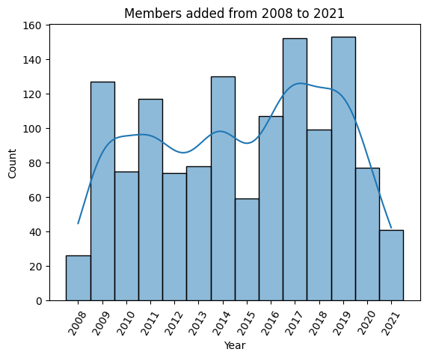
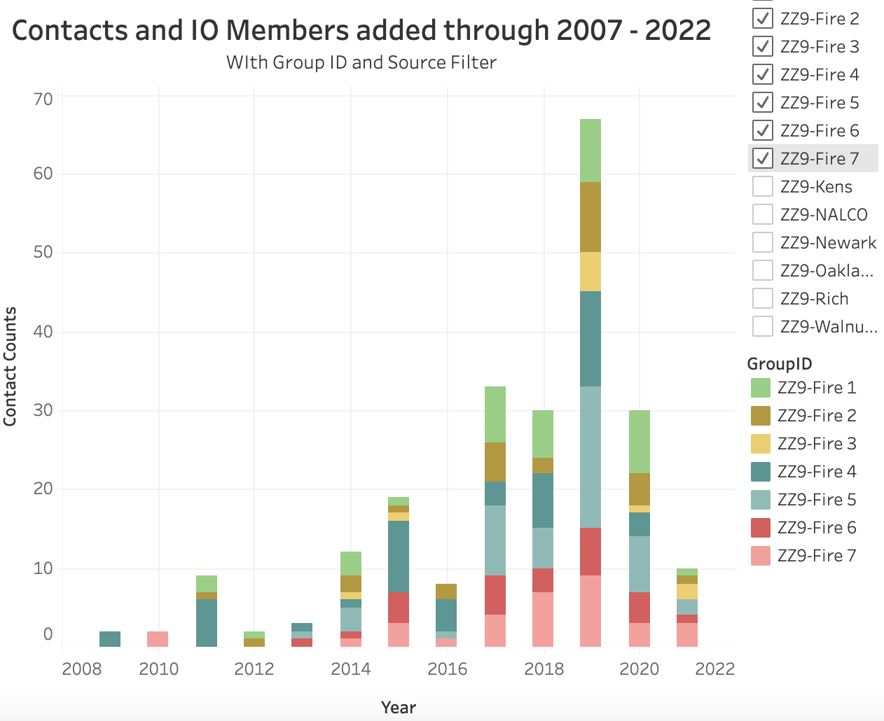
Member Analysis
Members added to BDPNN mail list and io group
2008 to 2021
Number of members in Fire Zone preparedness groups
2008 - 2022
Notes:
Susan
1: In general, the booming development of the BDPNN neighborhood network is 2014 - 2019. 2021 is a relative low ebb, probably due to COVID. Strategies or activities held in years like 2016 and 2019 can be good referential source for the future development of BDPNN.
2: Groups like ZZ9-Fire 1, Fire 5, Fire 7, were formed in 2013, and have lasted till 2021, with new members continuously added.

Slide 8
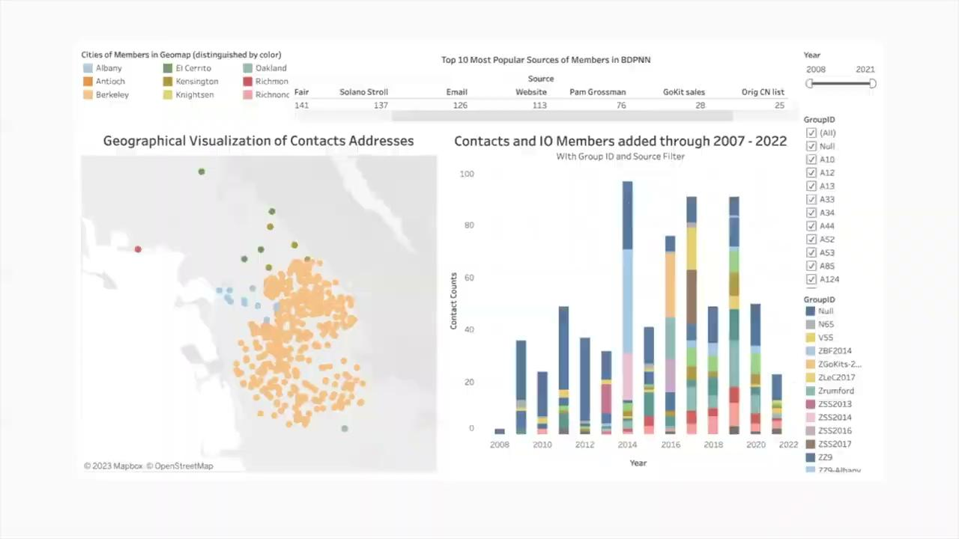
Membership Dashboard - Tableau
Notes:
Susan
We can see that the most popular sources from which members are added are BDPNN meetings, fairs, email reach out, and through the website, which can be continued in the future. Among all the fire district groups, the Fire 3 group (EastSouth part shown in the small square in this graph) seems to have the lowest number of members, which can be considered to improve in the future, in order to increase the completeness of the member network especially in the southern part of Berkeley.

Slide 9
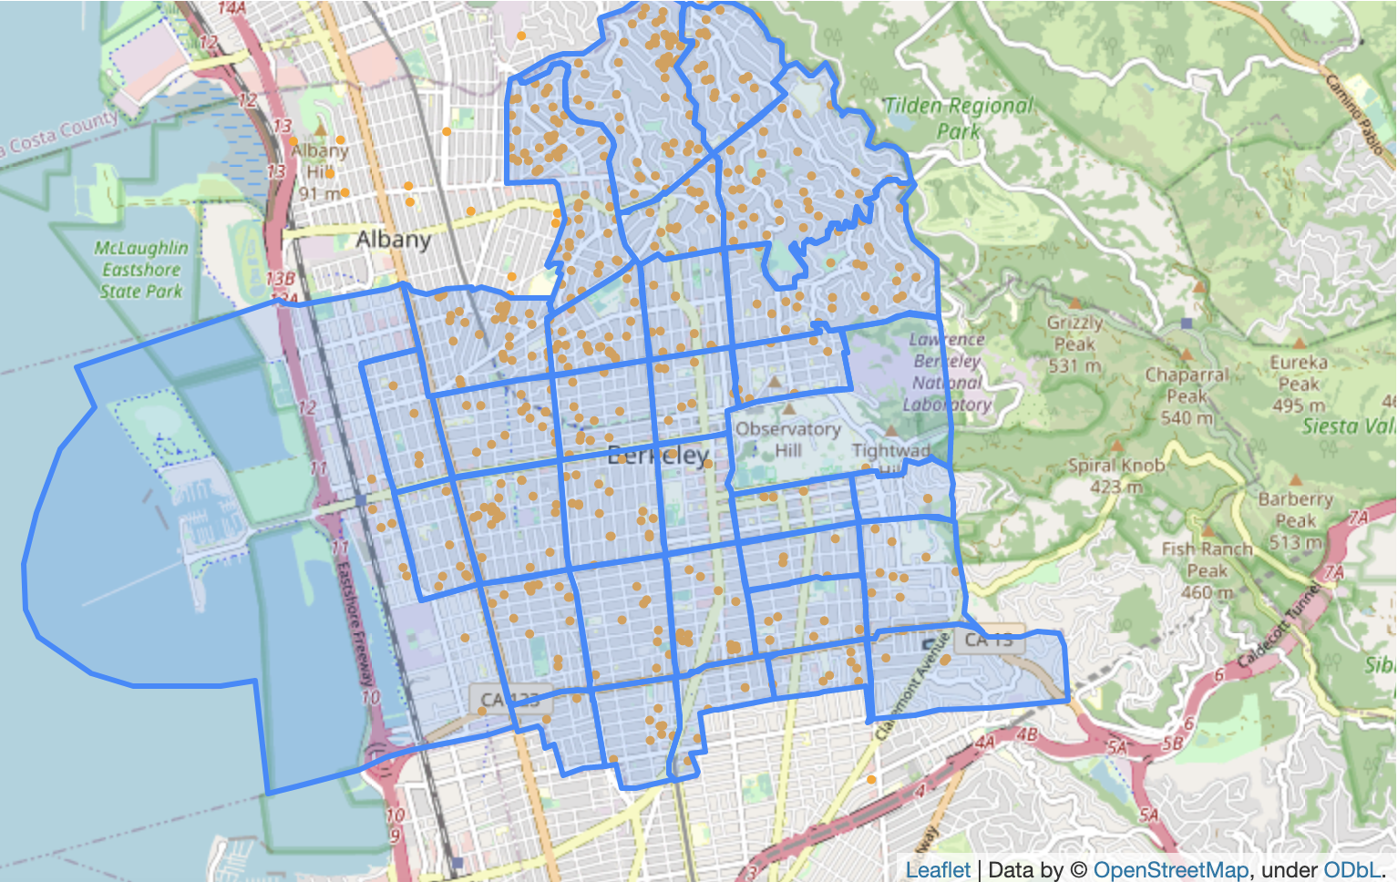
Mapping Member Locations
Geographical Visualization of the BDPNN Member Distribution
Notes:
Erin
We can see that the east and south parts may be worth developing more members to cover the areas more thoroughly. Richmond and Oakland can be considered as potential areas to expand the geographical range of BDPNN.

Slide 10
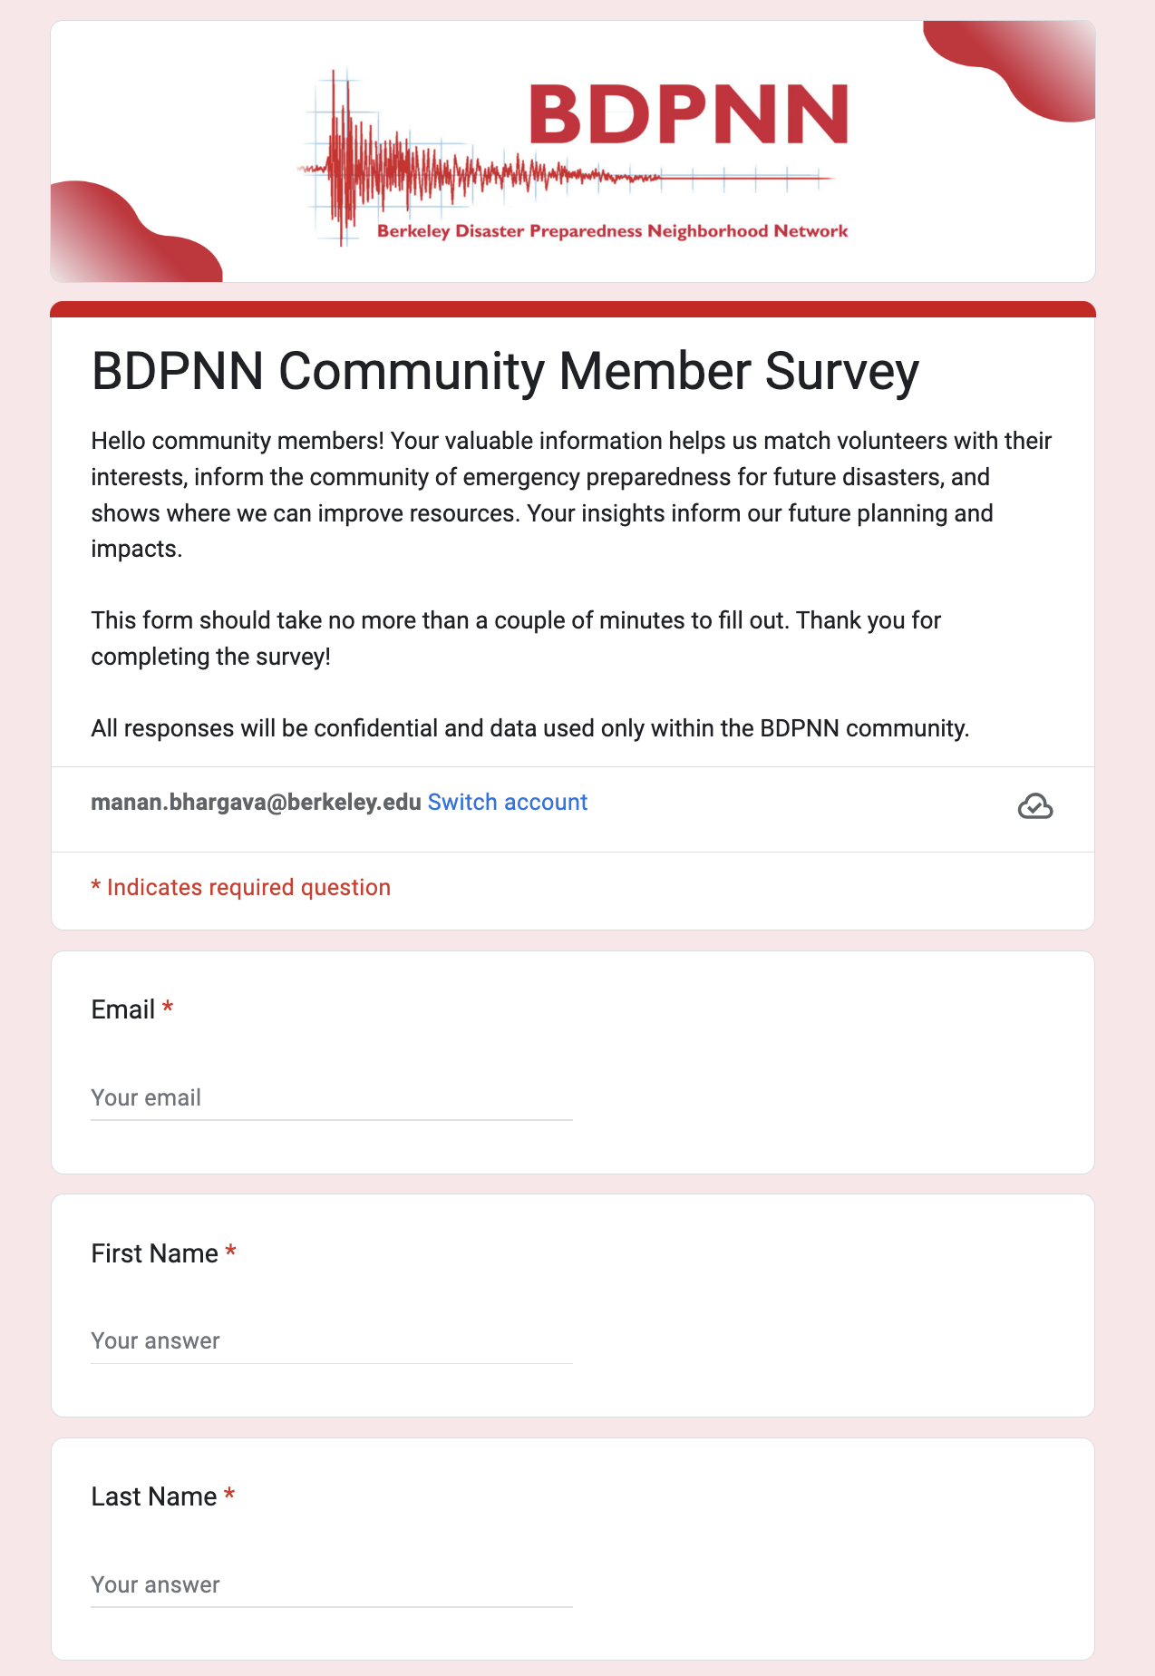
Survey
Demographics: Gender, Race, Age
Employment: Status, Work Experience
Current Involvement: Mailing List, Attended Meetings/Workshops, Neighborhood Leaders, taken CERT classes
Preparedness Information: Emergency Kits, Knowledge of Emergency Zones
Future Involvement: Attending a Meeting, Event Volunteering, Event Organizing
Notes:
Victor

Slide 11
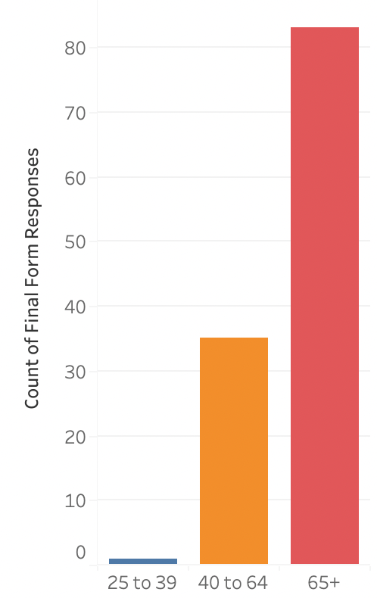
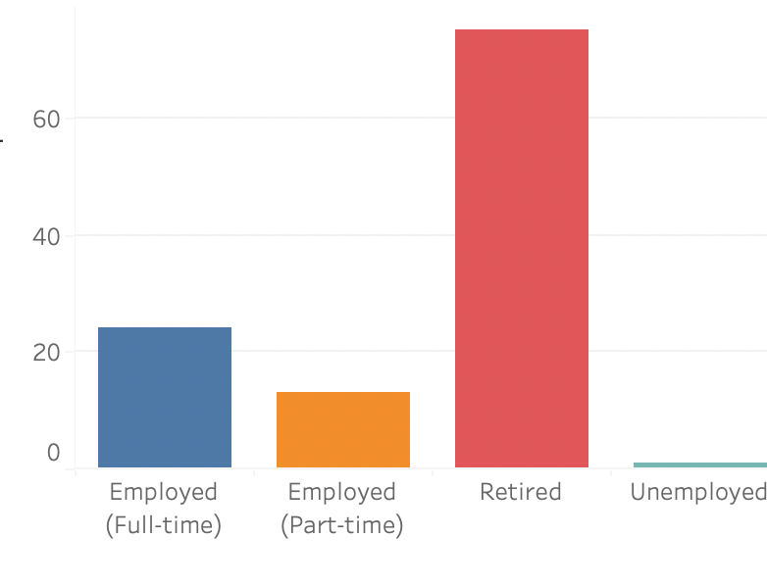
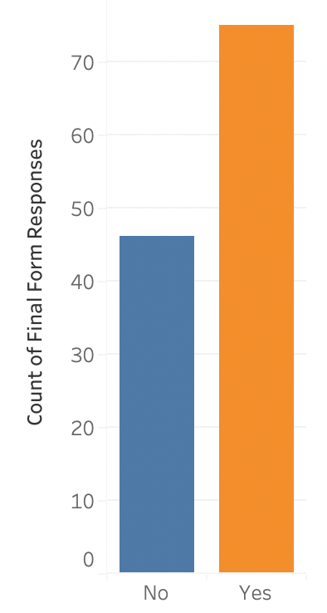
Survey Analysis
Age Range of Respondents
Interest in participating with BDPNN?
Employment Status
Notes:
Edwin: In order to take a more in-depth look at the demography of the BDPNN member base, we created a survey that was sent out to all of the emails in the list of contacts we were given. We received 121 responses over the course of a few weeks and the results are shown here. In terms of age range, most survey responders are over 65 years old with very little respondents younger than 40. BDPNN should look into expanding their outreach to younger age groups as well. In accordance with the age range, many of the respondents are retired as well. When asked whether they are willing to participate directly, the majority of respondents are willing, which is a good sign for future events.

Slide 12
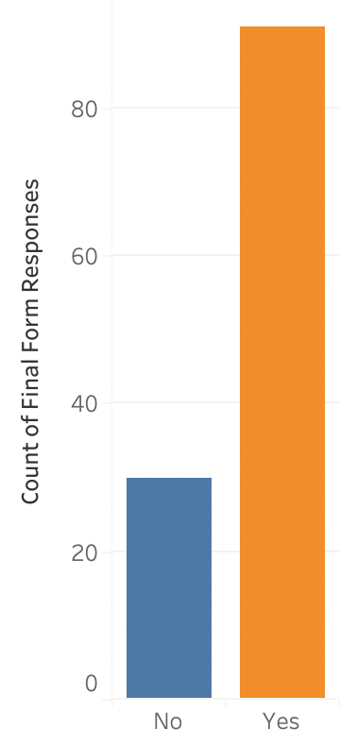
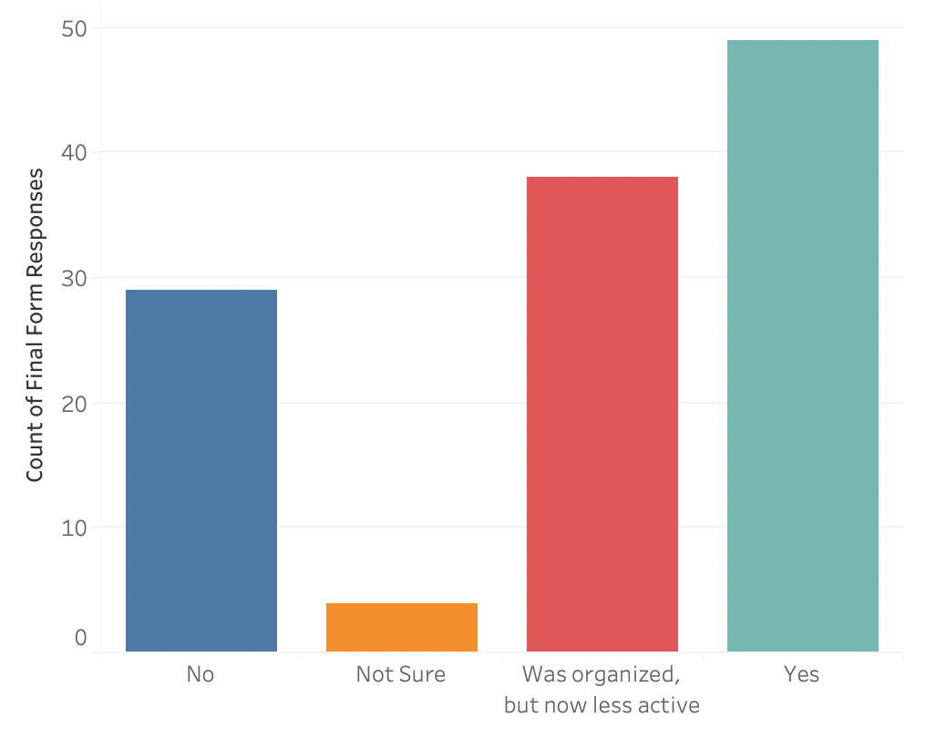
Survey Analysis (cont.)
Emergency Kit Ownership
Organized Group Status
Notes:
Edwin: We also found that a majority of respondents have an up-to-date emergency kit, however, there is still a good amount without them. A possible way to get more members to interact could be workshops to develop your own emergency kit. Also, when asked about neighborhood group organization, many respondents are organized, however, a lot of respondents also mentioned that their groups are less active than before. BDPNN can get in contact with those who are in those inactive groups to try to reignite them as well as create new groups for those without them.

Slide 13
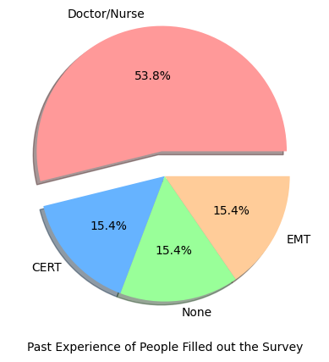
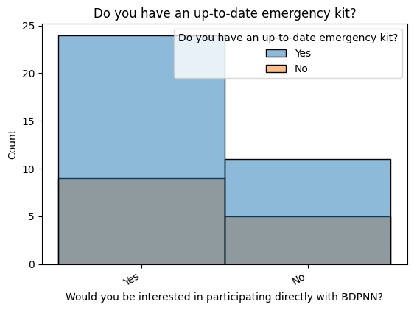
Survey Analysis (cont.)
Notes:
Edwin
L: Many of BDPNN members have medical, health, or CERT (Community Emergency Response Team) background, which proves the diversity and the trustworthiness of the network.
R: More than half of BDPNN members will be interested in participating directly with BDPNN in the future and most of them have an up-to-date emergency kit, which is good to help improve the preparedness of disasters. However, people with no up-to-date emergency kit are more reluctant to continue participating compared with those who have. It is recommended that BDPNN can provide members with emergency kits or hold workshops to help members prepare.

Slide 14
Demographic Insights Summary
69%
2%
62%
41%
75%
62%
Members 65+
Members 18-39
Members Retired
Neighborhood Groups Organized
Have up-to-date emergency kits
Interested in participating with BDPNN
Notes:
Victor

Slide 15
3.
Disaster Analysis
Notes:
Lam

Slide 16
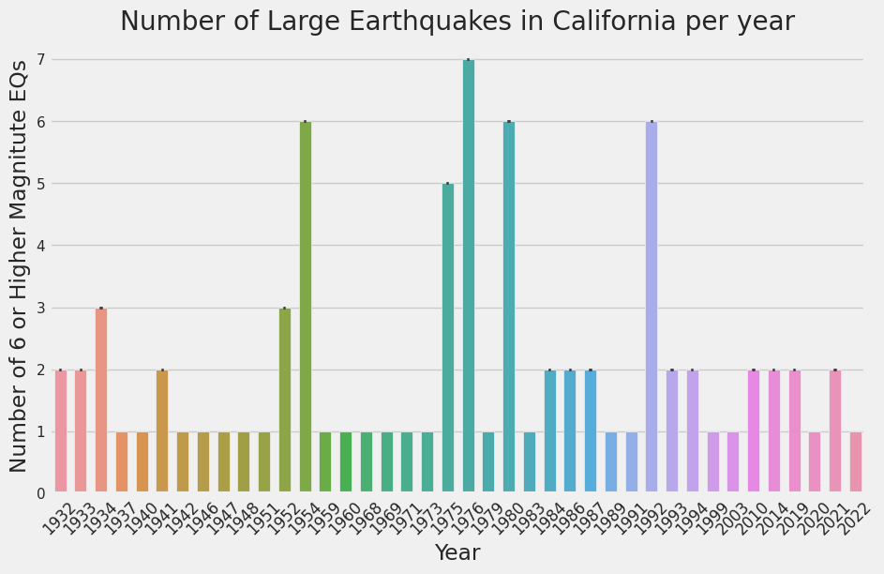
Earthquakes Over Time
Large earthquakes are those of magnitude 6 or higher.
Notes:
Lam

Slide 17
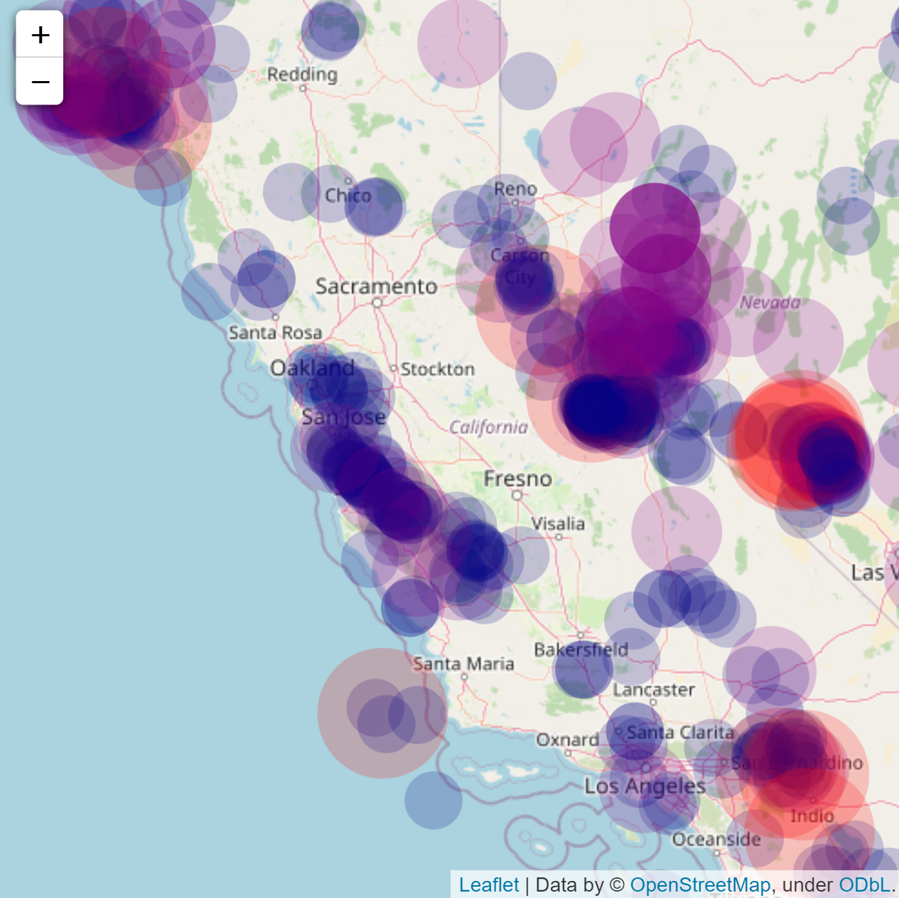
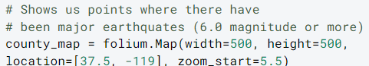
Earthquakes
Locations of impactful earthquakes over past 90 years.
Most condensed around Hayward, San Andreas fault lines
Notes:
Lam
This map shows the locations of Impactful Earthquakes (Magnitude 4.5 and above) over the past 90 years. We see that a lot of them are focused around the fault lines. One major fault line goes through San Jose and San Francisco and another through Fremont and to the east of Oakland. The earthquakes in this area are the ones that are most impactful for Berkeley, Albany, and other Bay Area residents.

Slide 18
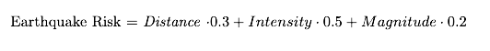
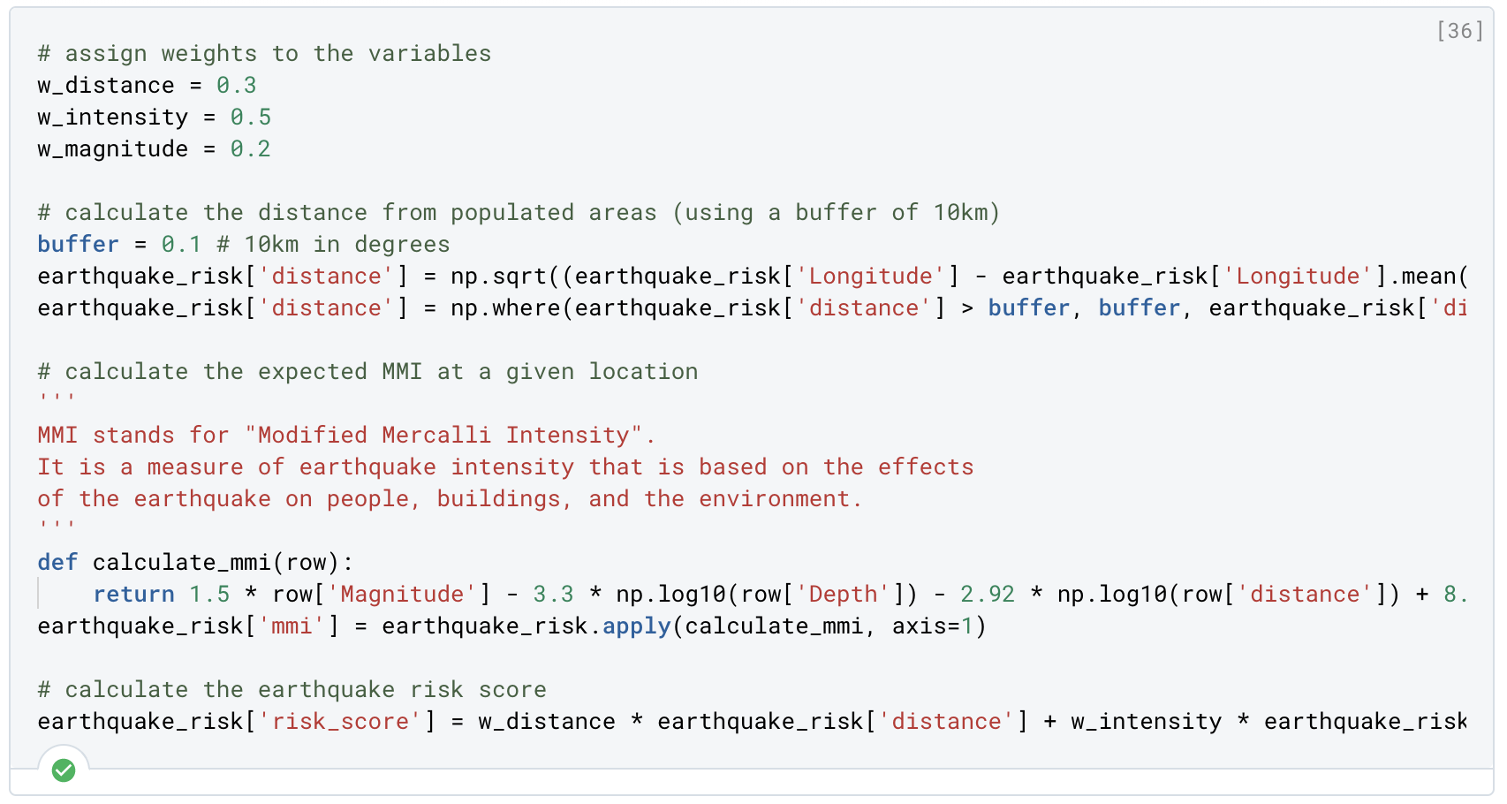
Earthquake Risk Calculation
Distance is calculated based on latitude and longitude, and filtered by a buffer value.
Intensity is calculated based on Magnitude and Depth.
Weights are assigned to all 3 features.
Notes:
Susan - We calculated the risk of being affected by an earthquake by using the distance from earthquakes, the intensity of them, magnitude, and their weights.

Slide 19
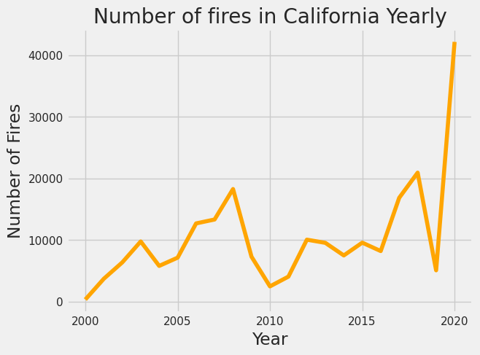
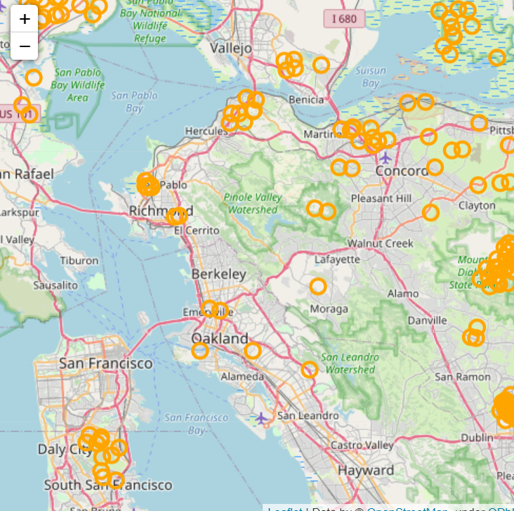
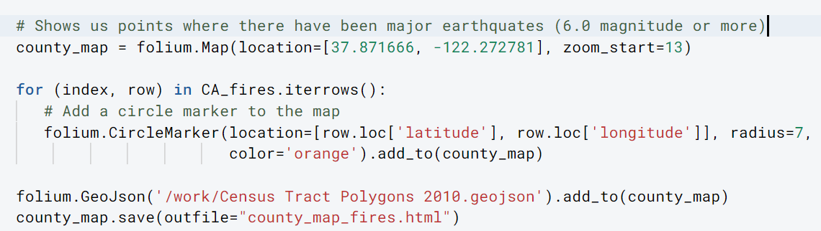
Fires
Notes:
Kaan

Slide 20
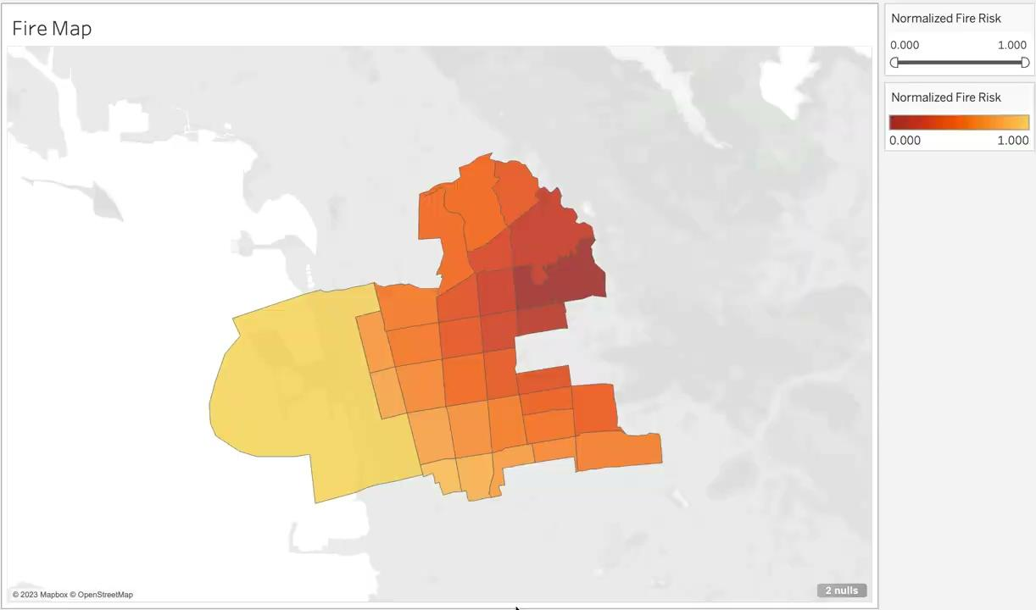
Mapping Wildfire Risk
Notes:
Kaan

Slide 21
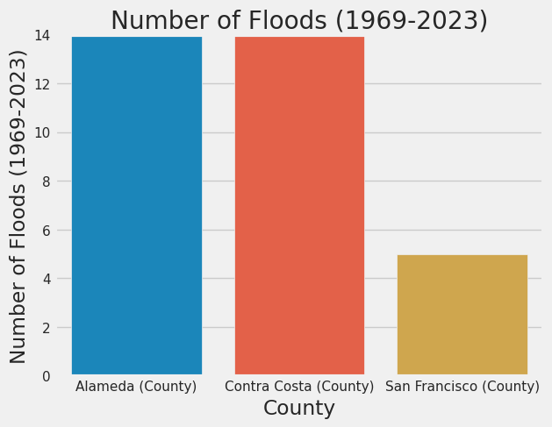
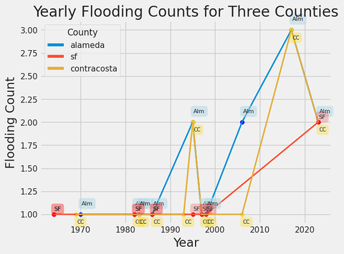
Floods
Alameda county is overall similar to other counties in the area for flood risk. San Francisco in particular is an outlier.
Flooding situation in Alameda, SF, Contra Costa
1960 to 2020
Notes:
Lam
Right: After doing some research, we filled the missing values of flooding counts in SF. Contra Costa and Alameda both have a severe increasing trend from 2000 to 2020. Flooding situation becomes more severe than past in the last 20 years for three counties.

Slide 22
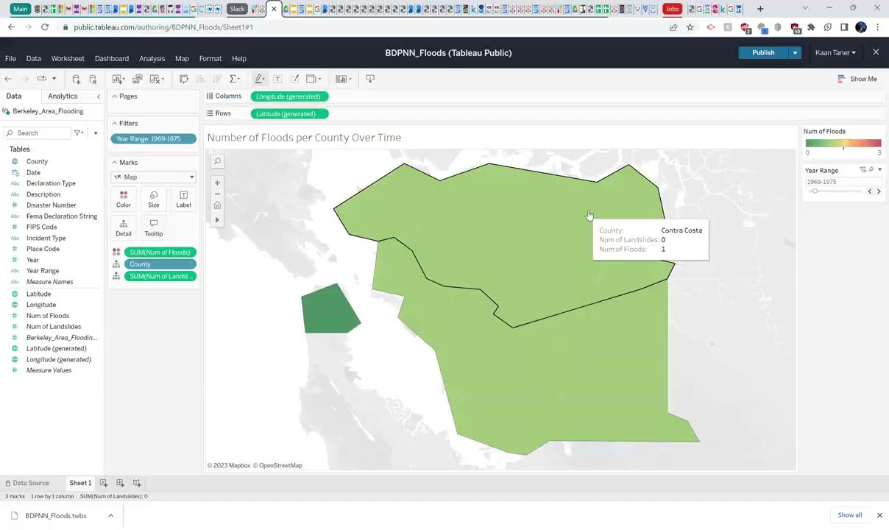
Flood Visualization
Notes:
Kaan

Slide 23
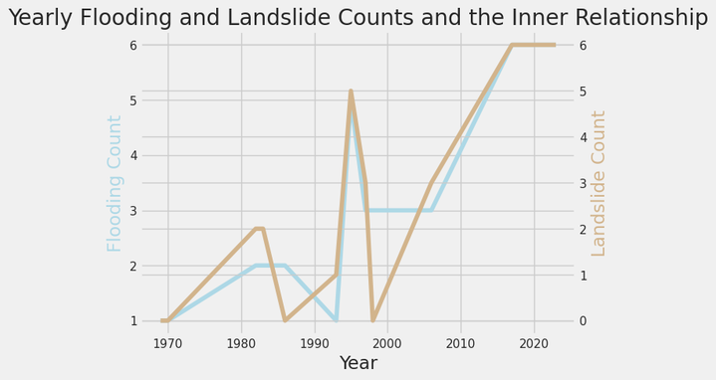
Flooding and Landslides
Notes:
Kaan - We can see that there is a close relationship between flooding and landslides in California. And it seems that except 2000, most years flooding has positive and a slightly lagged relationship with landslide

Slide 24
Heuristic Calculation
Interpret: we calculated a heuristic value based on the normalized features including member count, member experience, future participation rate, fire disaster risk, and earthquake disaster risk in each census tract.
The higher the value is, the safer that area is.
Notes:
Susan

Slide 25
Heuristic Calculation
45% Member Count
Number of members plays a large role for regions with more involvement
20% Experience Level
Past experience scaled contributes to that disaster zone being “better”
25% Participation Percentage
Those willing to participate increases zone being “better”
5% Fire Risk
Minor difference between regions closest to mountains and areas further from the mountains
5% Earthquake Risk
Geographically, earthquakes affect the city of Berkeley with practically the same effect - since Berkeley is a relatively small city
Notes:
Susan

Slide 26
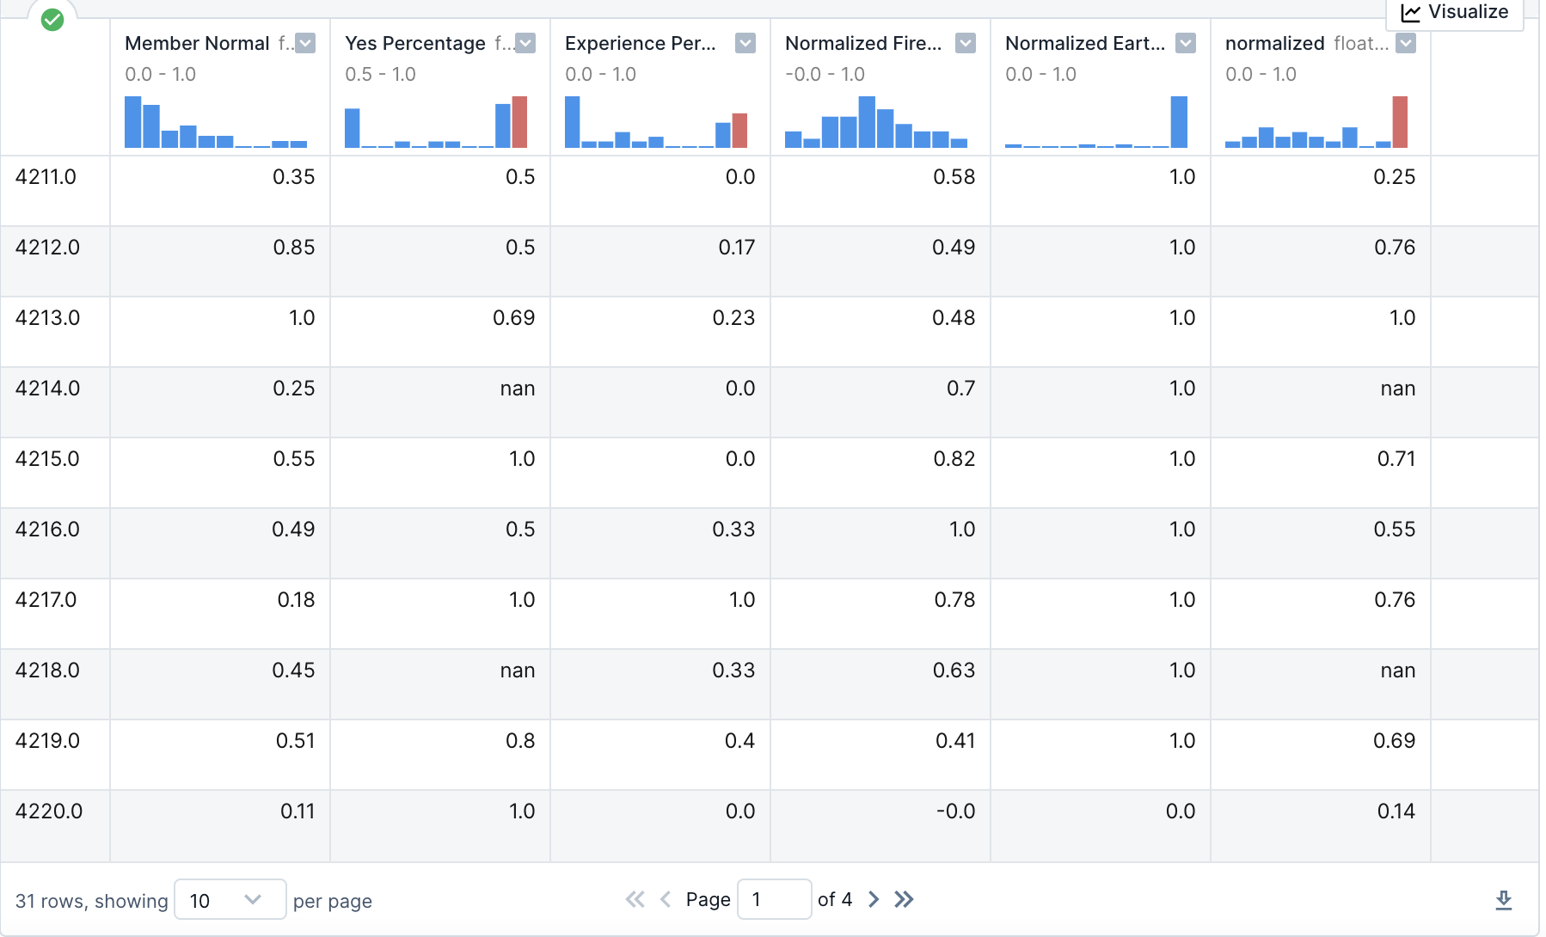
Outreach Scoring Matrix
Normalized heuristic
Notes:
Erin

Slide 27
4.
Recommendations
Notes:
Erin

Slide 28
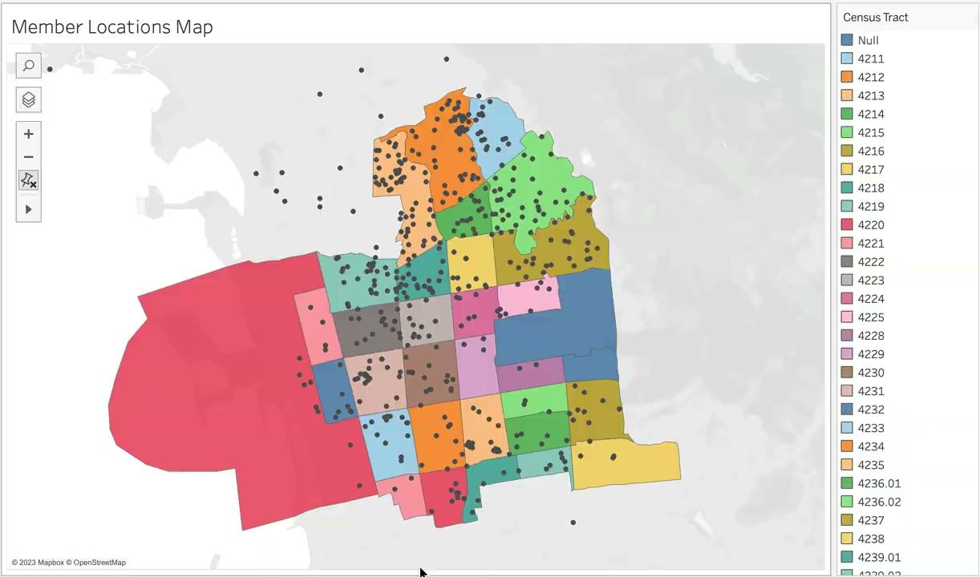
Map: Member Locations
Notes:
Erin

Slide 29
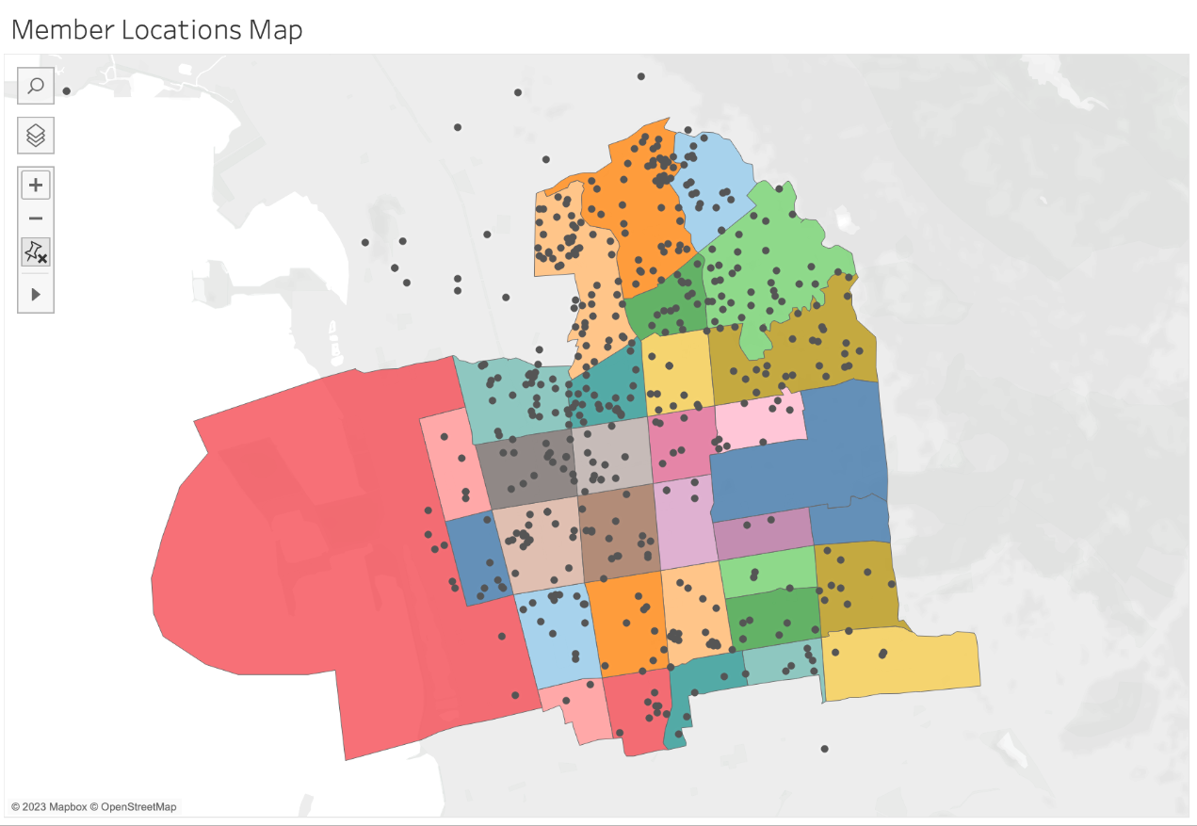
Map: Member Locations
Notes:
Erin

Slide 30
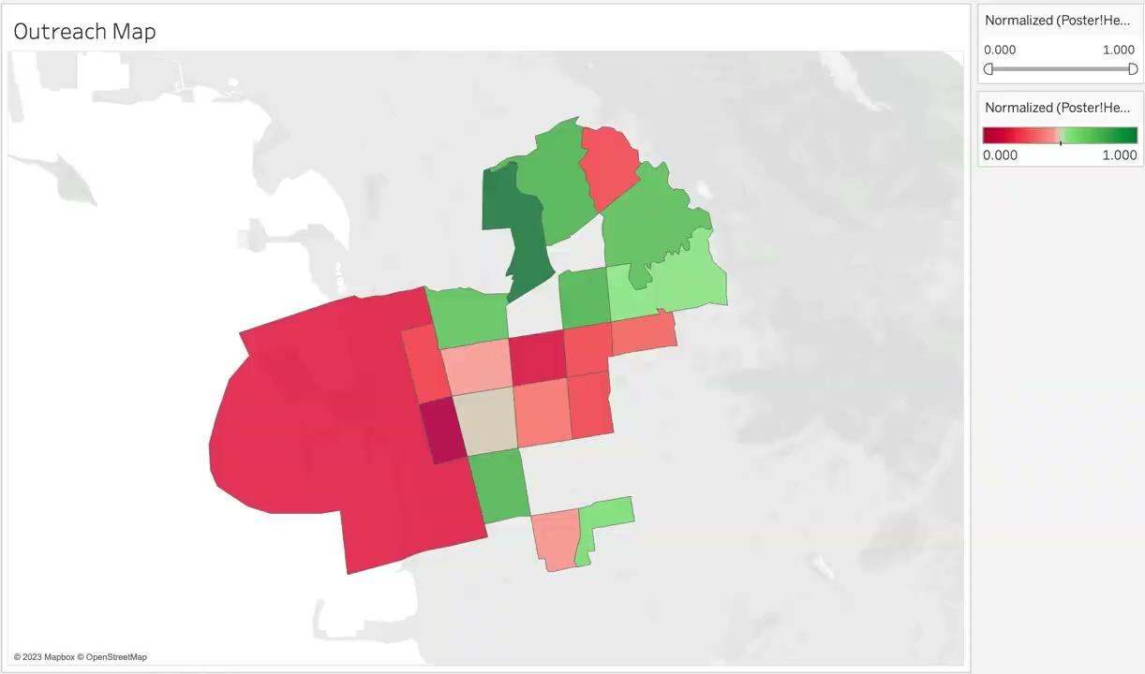
Map: Outreach Recommendation
Redder areas: Increase outreach due to higher risk from heuristic
Notes:
Erin

Slide 31
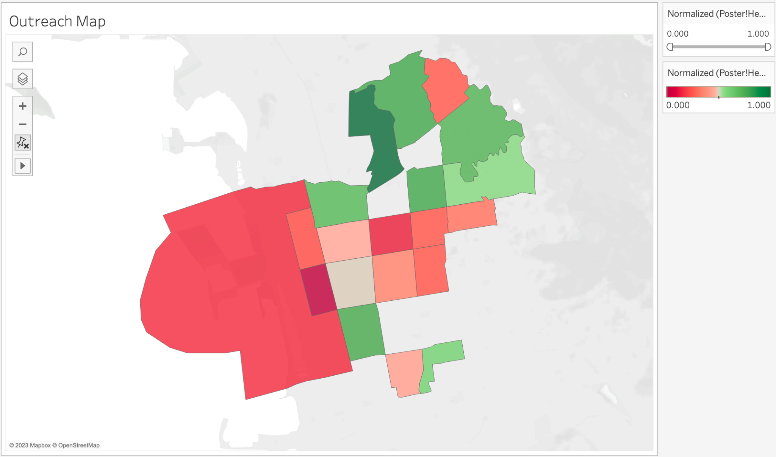
Map: Outreach Recommendation
Notes:
Erin

Slide 32
Outreach Recommendation
According to our scoring system, it is suggested that BDPNN focus outreach efforts on census tract groups in the southern and western areas of Berkeley, specifically census tract groups:
Top 3: 4232, 4223, 4220
4221, 4222, 4224, 4225, 4229, 4230, 4240.01, 4211
These areas have been identified as requiring the most attention due to a combination of different factors including their risk for natural disasters and willingness of experienced members to volunteer.
Notes:
Erin

Slide 33
Demographic Recommendation
Younger: <65+
?
Diverse Races/Ethnicities
Notes:
Victor

Slide 34
5.
Tech Stack
Notes:
Erin

Slide 35




Tech Stack
Tools: DeepNote, Tableau, Google Sheets
Languages: Python
Libraries: Pandas, Numpy, Matplotlib, Seaborn, Geopy, Geopandas, Folium, Tensorflow
Notes:
Erin

Slide 36
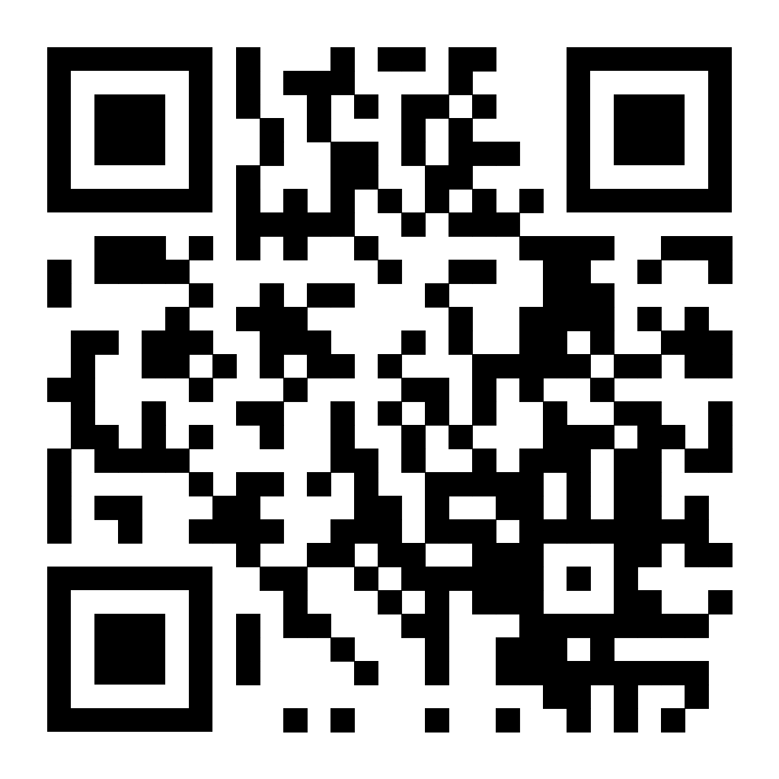
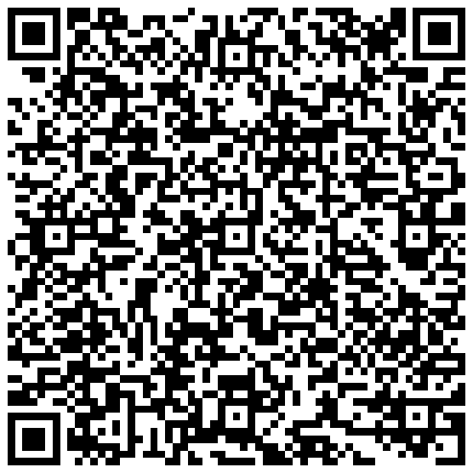
Interactive Tableau Dashboards
Membership Dashboard
Map Dashboard
Notes:
Manan

Slide 37
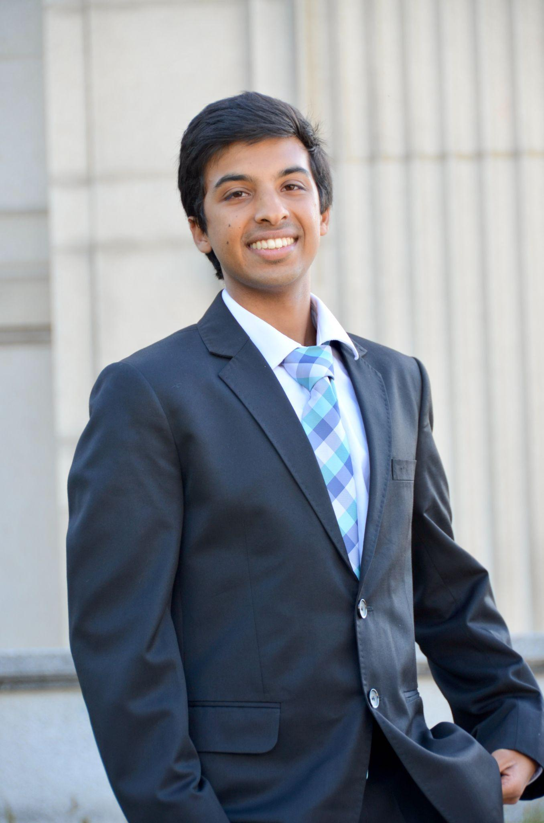
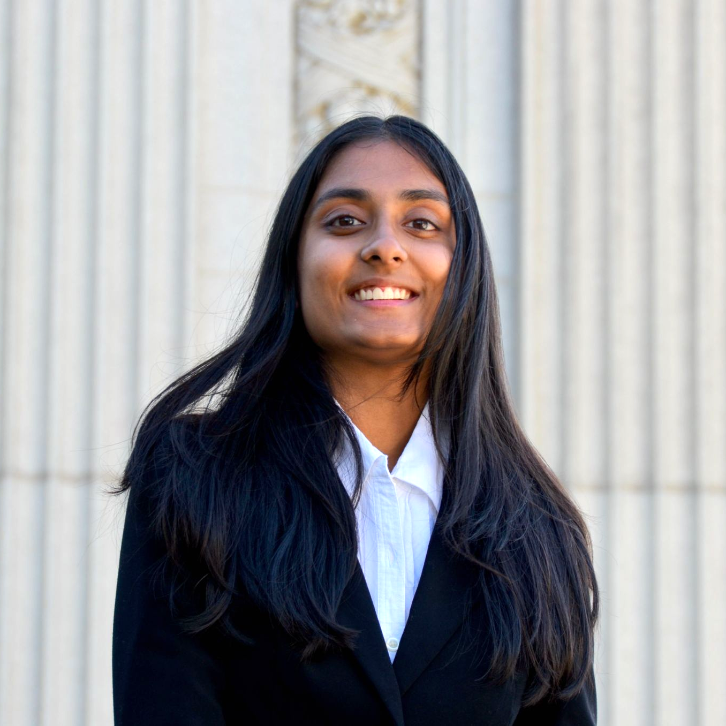
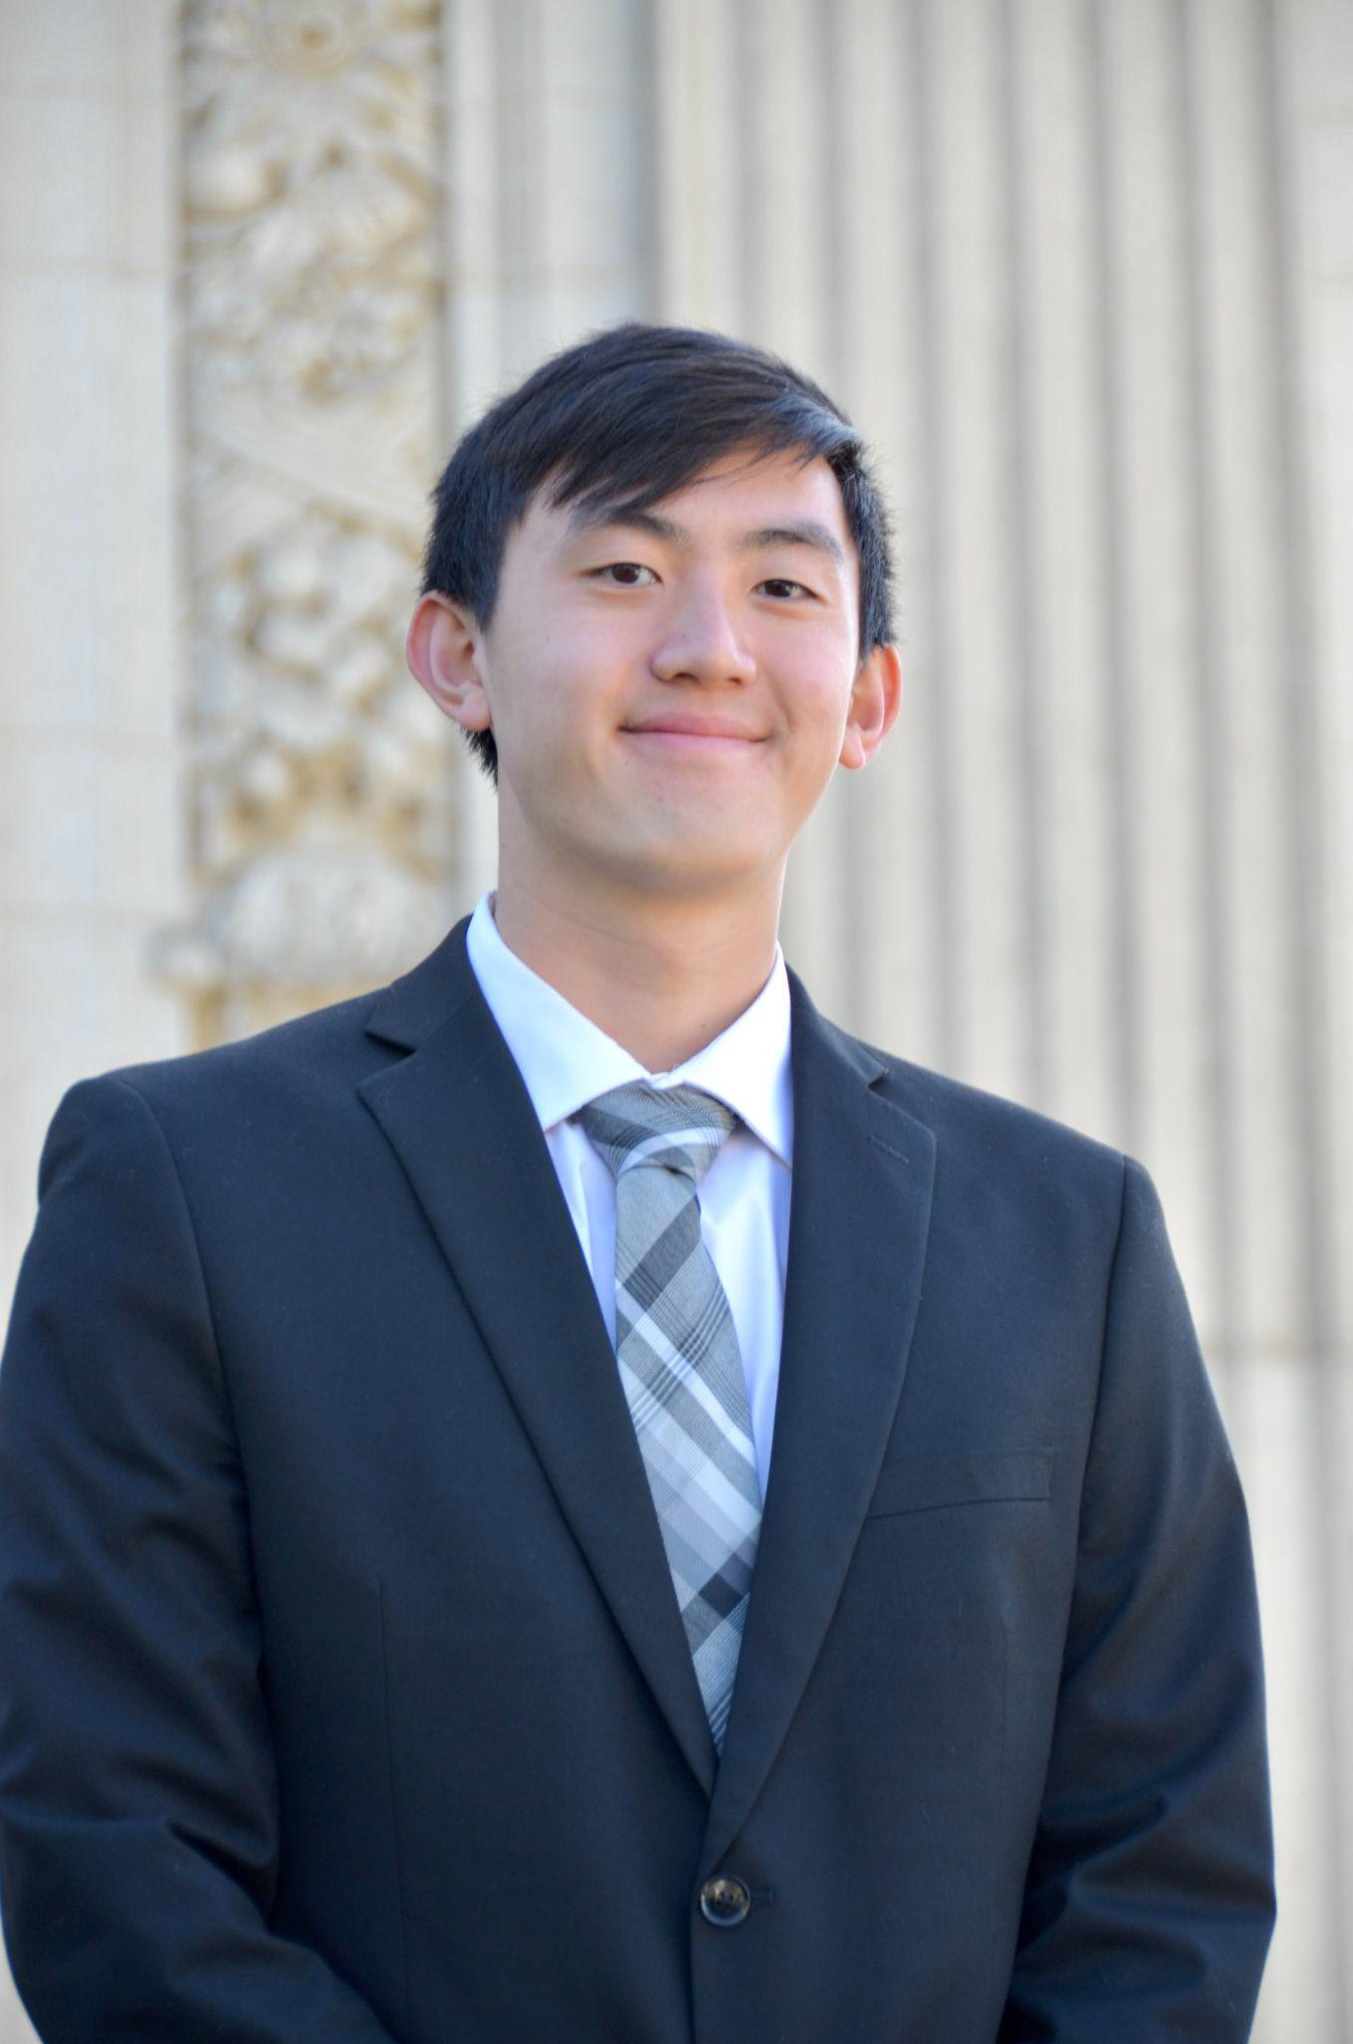
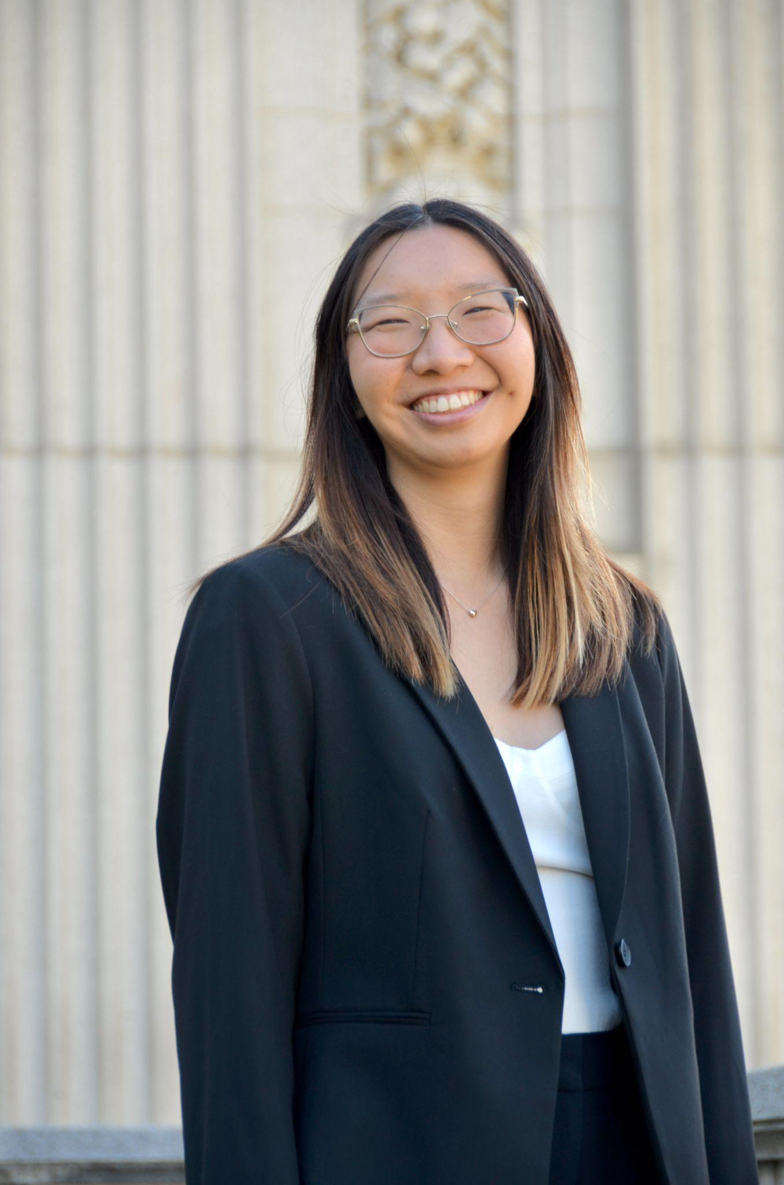


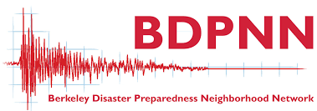
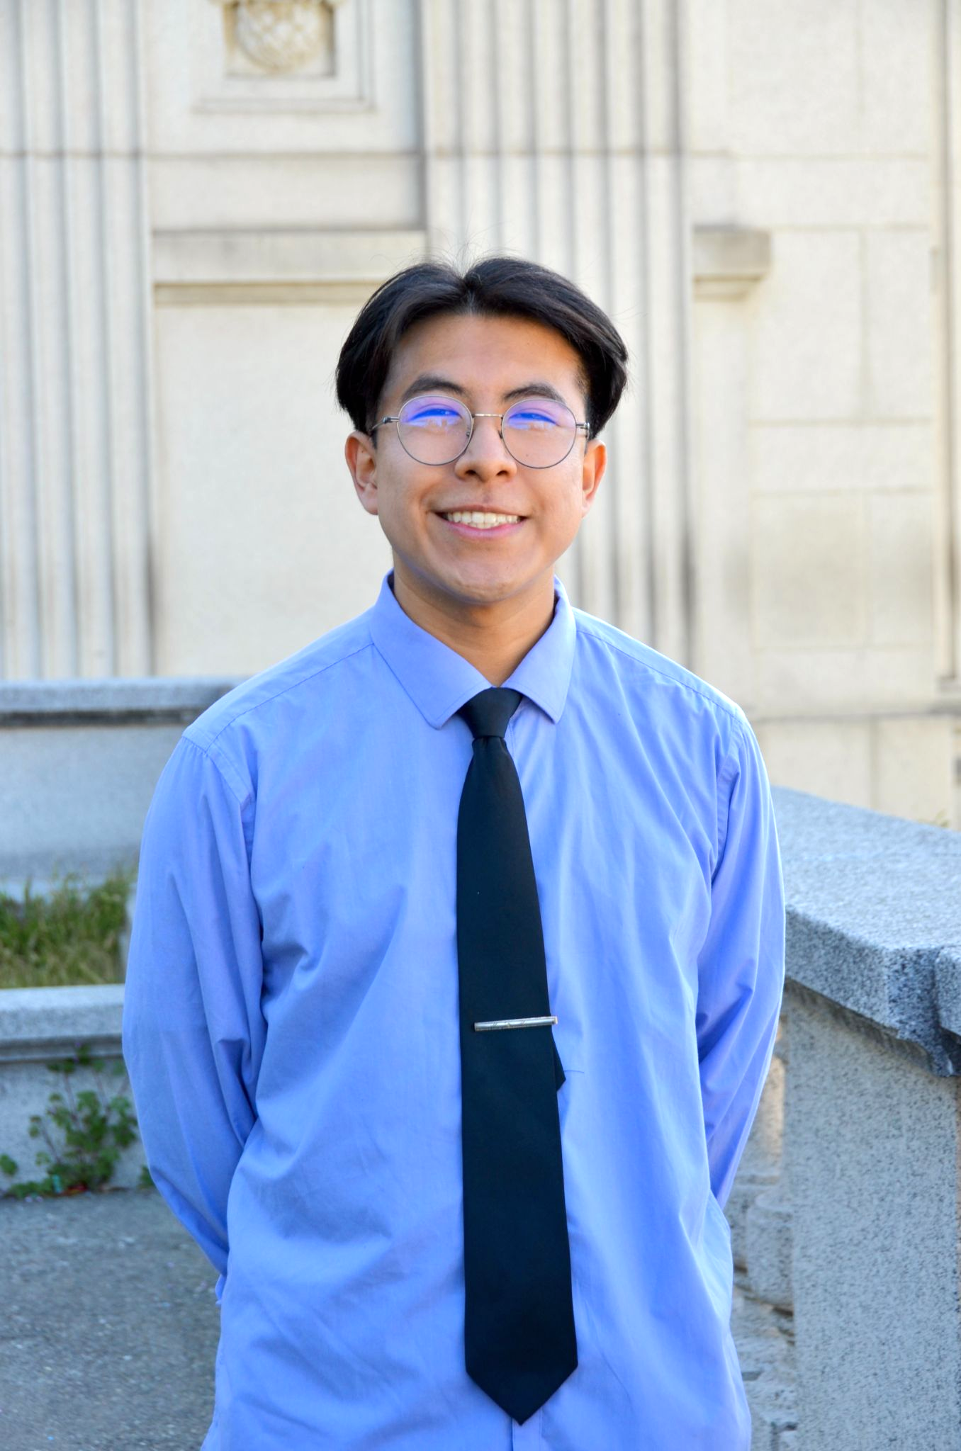
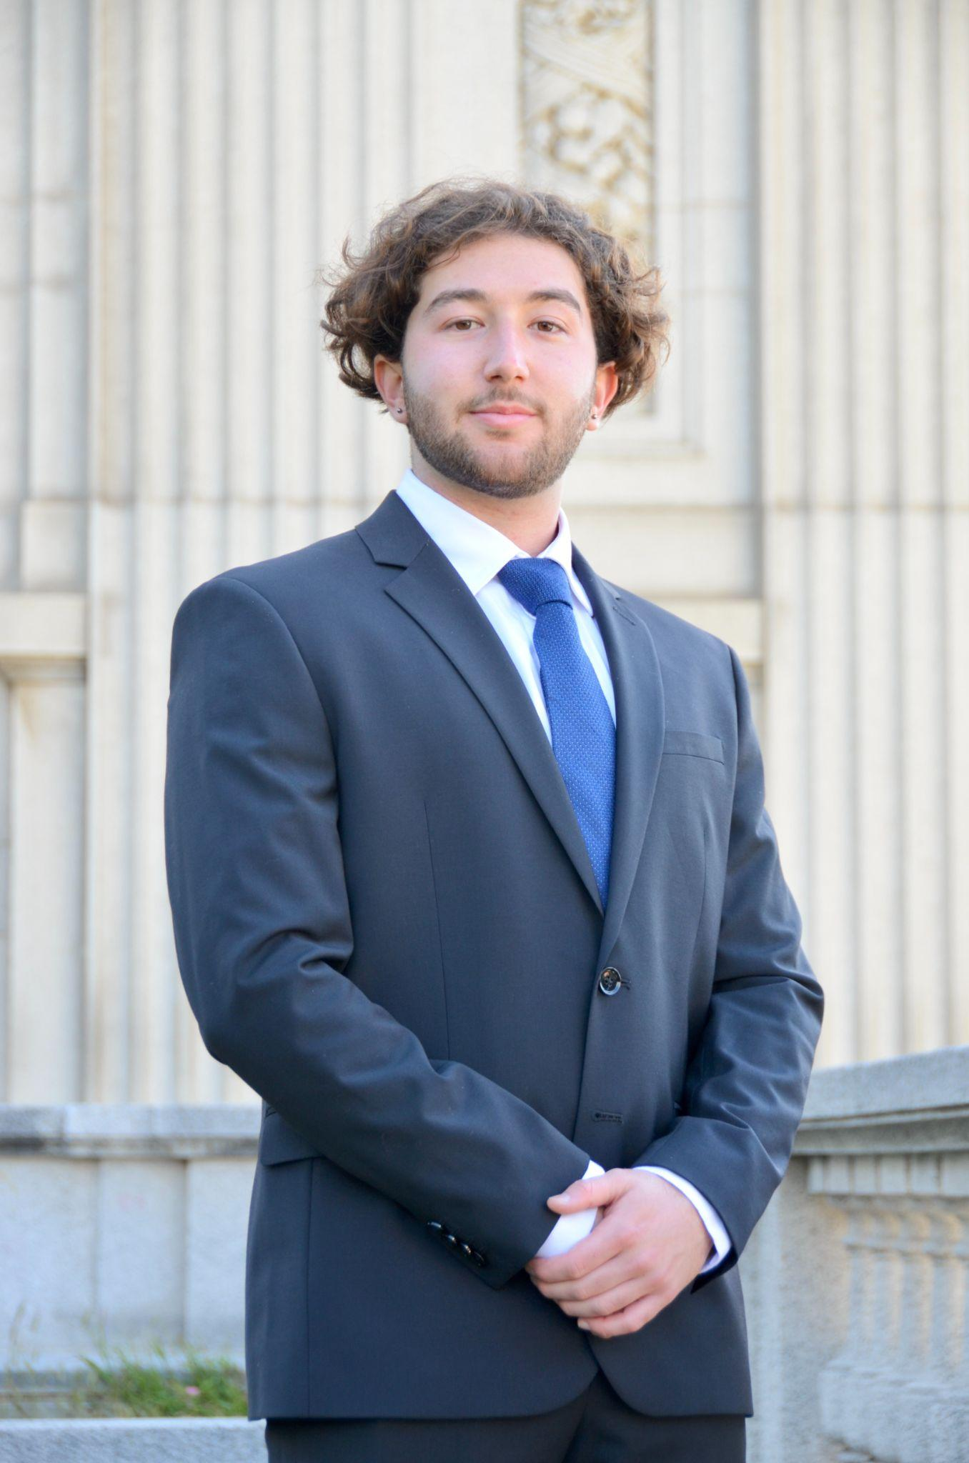
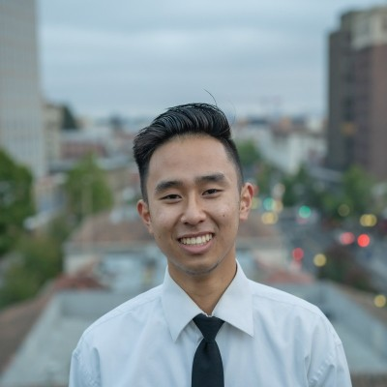
Thanks!
Any questions?
Notes:
Manan

